Slide 1
The Antoniades - Patriarchal
Greek Text of The New Testament and its reception in East & the West
Convocation 2012
Holy Trinity Orthodox Seminary
Celebrating the Centennial
of the second edition of the Patriarchal New Testament
Nikolaos Adamou

Slide 2
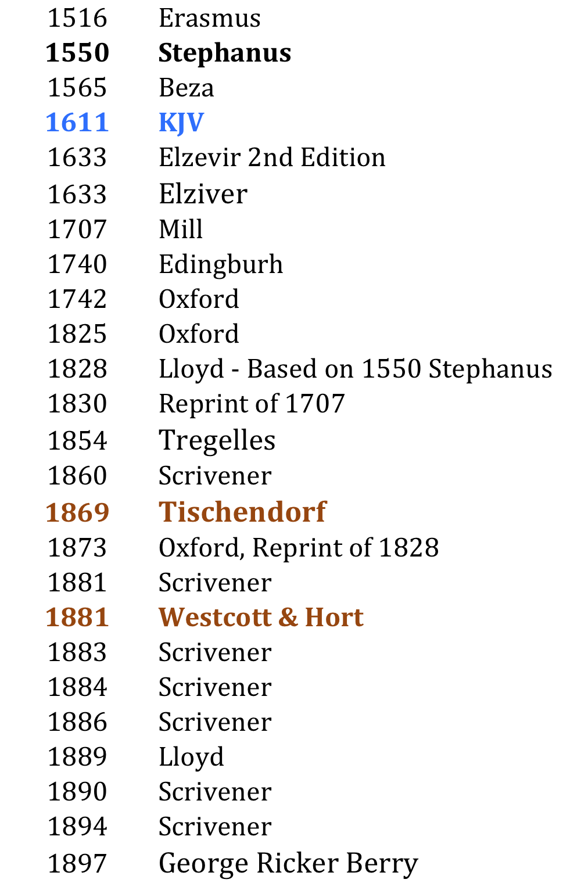
Greek New Testaments in the West

Slide 3
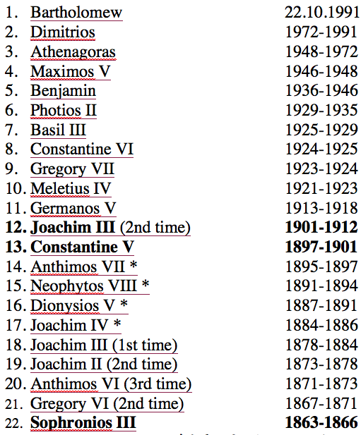
Patriarchs in Constantinople

Slide 4
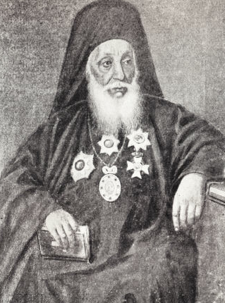
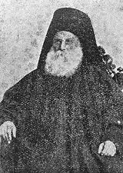
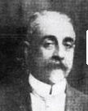
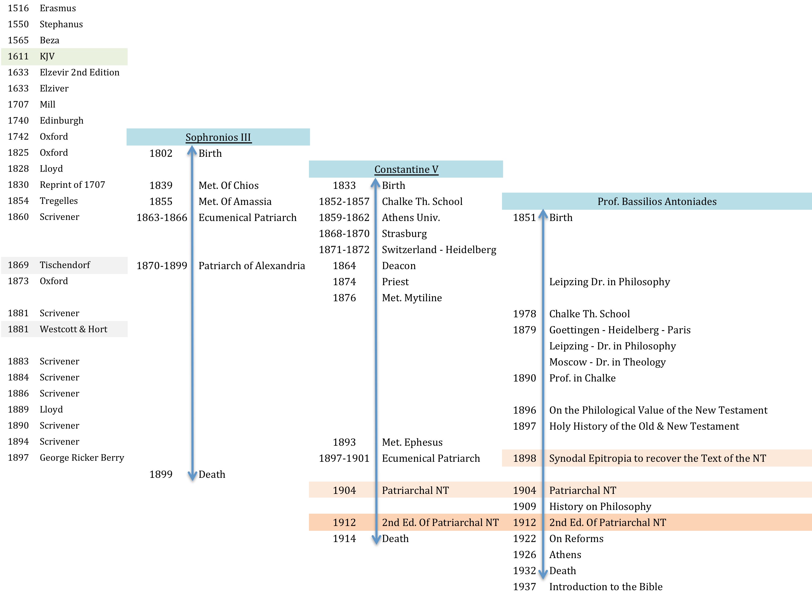

Slide 5
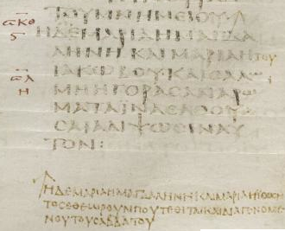
Text using MSS
Codex Sinaiticus
η δε μαρια η μαγδα
ληνη και μαρια η ┬
ϊακωβου · και ϲαλω
μη ηγοραϲαν αρω
ματα ϊνα ελθου
ϲαι αλιψωϲιν αυ
τον :
η δε μαρια η μαγδαληνη και μαρια η ϊωϲη
τοϲ εθεωρουν που τεθιται και διαγενομε
νου του ϲαββατου

Slide 6
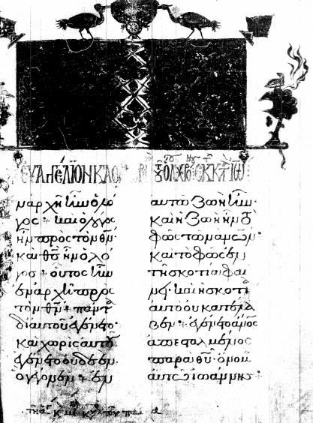
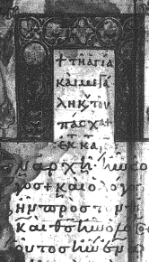
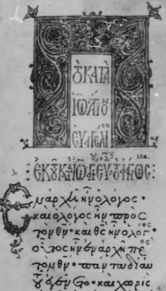
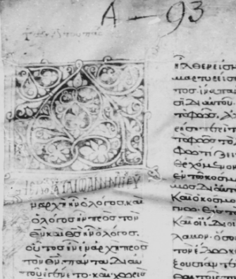
stones which the builders rejected

Slide 7
Antoniades’ Textual Choices
** Theological School of Chalke, 1, 3a, 4 7
of the Monastery and 1, 2 β
** Commerce School of Chalke
†167, 168β , 170, 171, 172, 173
** Dependency of Monastery of Holy Sepulchre in C/ple 11, 272, 649
** St. George by the Gate of Adrianople, two,
† only for Sundays (ἀτελές not incomplete) ,
the other complete (from the MSS of the Church of the Holy Wisdom)
β Byzantine type, † kept in sacristies, ** those collated in the preparation of the text

Slide 8
Antoniades, §9
…among the later (MSS) there are some
no less esteemed and venerable
than many of the earlier,
since they are taken from earlier copies, particularly the Theological School 9, date 1688, but preserving certain peculiarities
of the more ancient copies,
among other features the omission of
I John 5:7,8, of the three witness in heaven. …

Slide 9
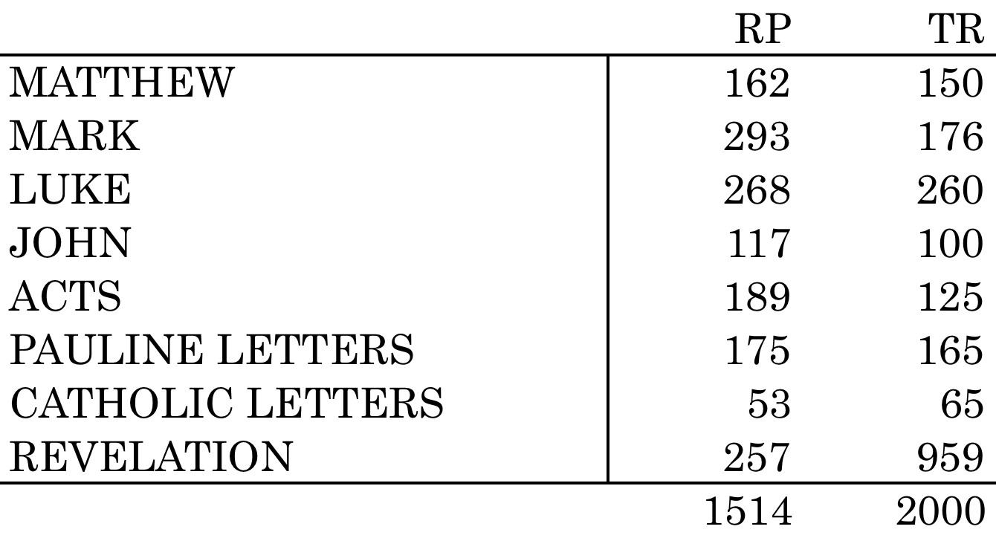
Variances
http://koti.24.fi/jusalak/GreekNT/NTTexts.htm
http://www.cspmt.org/pdf/printed_editions/Antoniades-1904-Greek-NT.pdf

Slide 10
Antoniades’ difference in opinion with the Patriarchal Synod
The pericope of the adulterous woman, John 8:3-11
the passage on the “three witnesses”
I John 5:7,8

Slide 11
Eastern Apathy & Ignorance
Phænomenal acceptance by Apostoliki Diakonia – Variances Exist
Elimination of print variances
Elimination of footnotes
Parallel usage of Saliveros Lectionary in Church
Usage of TR (Trembelas, Soteropoulos et. al)
Absence of Academic discussion
Recent cooperation & dependency on the
Greek Bible Society
Extensive usage of the Nestle-Aland text for
non Liturgical purposes

Slide 12
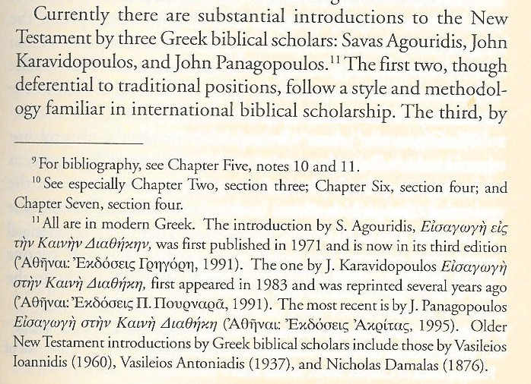
Stylianopoulos – footnote one on page 5

Slide 13
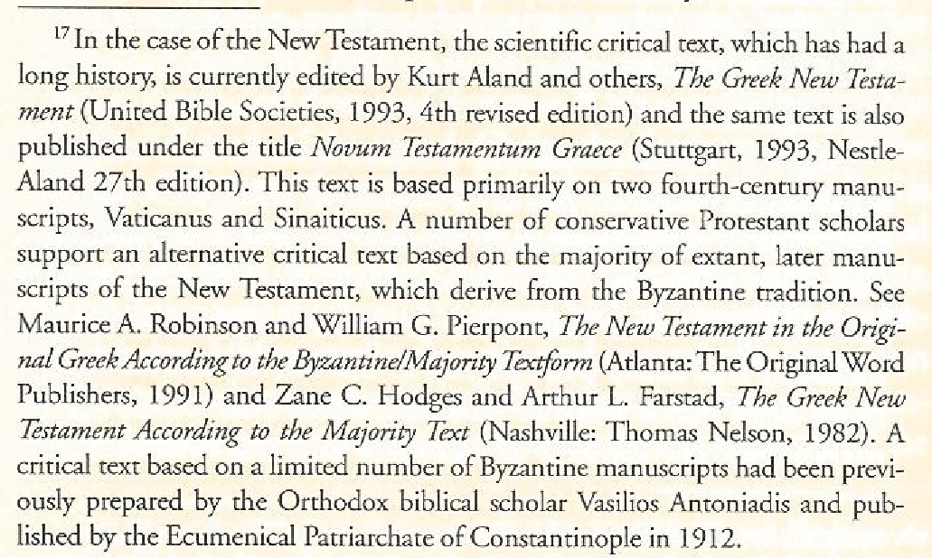
Stylianopoulos – footnote two on page 137

Slide 14
Rife - The Western Rejection 1
No Critical Apparatus
The assigned object was to recover,
insofar as possible,
of the oldest ecclesiastically transmitted text, especially that of the Church of Constantinople.
Minority readings were given.

Slide 15
…no criticism was made of the authority of the text of the MSS. There was
no transposition,
no substitution,
no addition,
no excision,
except in rare cases, and these with sufficient testimony elsewhere. …
Antoniades, Introduction

Slide 16
Rife - The Western Rejection 2
Devotional Character/ Liturgical Usage
Parallel & Antithetical passages in footnotes
Liturgical Tables
THE BIBLE IS THE BOOK OF THE CHURCH
Liturgical & Devotional
by NATURE & HISTORY

Slide 17
Rife - The Western Rejection 3
Follows grammatical standards
rather than the MSS
One can not correct some of the errors of the MSS and leave others not corrected.
Choice of orthography impacts the meaning
Choice of punctuation reflect syntax
as well as oral usage

Slide 18
Rife - The Western Rejection 4
Continues text is prepared from lectionaries
Lectionaries contain at the end the omitted text.
Lectionaries contain less errors in transmission
Utilization of complete texts as well

Slide 19
Rife - The Western Rejection 5
Assumed Authority to Saliveros publication based on unnamed TR sources
Antoniades’ lectionary MSS sources are taken from the most reliable areas of the Constantinople’s Church
Church of Hagia Sophia,
Chalke Theological School & Seminary,
Chalke Commercial School,
Metochi of Holy Sepulchre in Constantinople

Slide 20
Rife - The Western Rejection 6
Not the better representative MSS than TR
MSS used in the Church, TR is a Western, not an Orthodox Church document
Patriarchal text is an ANSWER to TR
Recent acceptance of Antoniades
(Klaus Wachtel,
Early Variance in the Byzantine Text of the Gospels, 2006)

Slide 21
Rife – other references
Colwell (Studies in the Lectionary Text, 82-83)
Lake (Harvard Theological Review, XXI, 349-357)
There are relevant to Antoniades’ text at all

Slide 22
Conclusion
Current availability of MSS used by Antoniades permit further investigation.
Does the Church have a text?
Is this text the Antoniades text?
Are Antoniades’ orthography & punctuation correct?
Compare & Contrast old Slavonic MSS against Antoniades text

Slide 23
